Slide 1









RSVP Movies Case Study
(Segment-3)

Slide 2

PROBLEM BACKGROUND
RSVP Movies is an Indian film production company which has produced many super-hit movies. They have usually released movies for the Indian audience but for their next project, they are planning to release a movie for the global audience in 2022.
The production company wants to plan their every move analytically based on data and have approached us for help with this new project. We have been provided with the data of the movies that have been released in the past three years. We have to analyze the data set and draw meaningful insights that can help them start their new project.

Slide 3
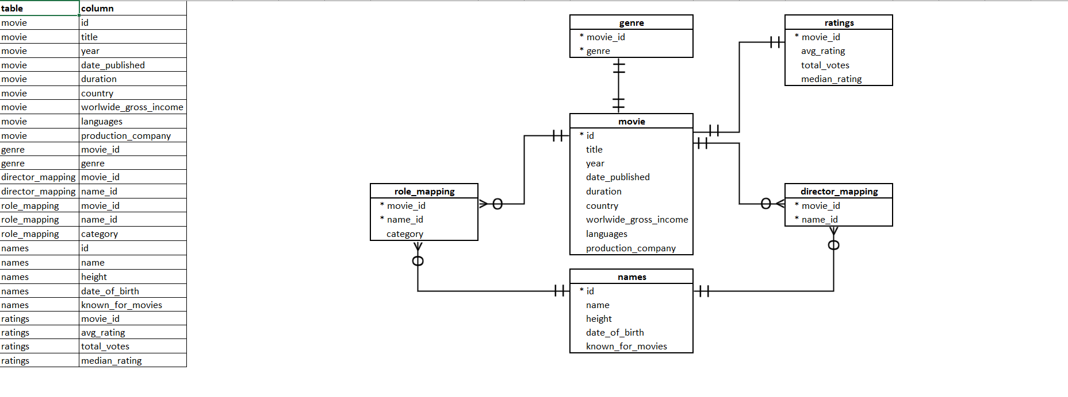
DATABASE SCHEMA

Slide 4
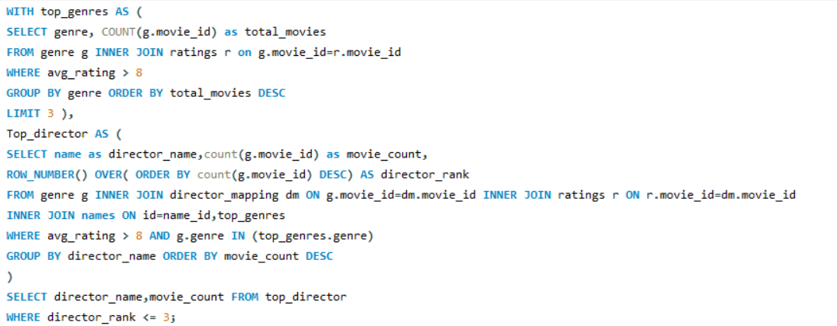

Q1.Who are the top three directors in the top three genres whose movies have an average rating > 8?

Slide 5
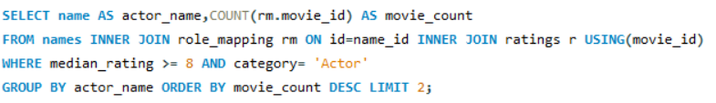

Q2. Who are the top two actors whose movies have a median rating >= 8?

Slide 6
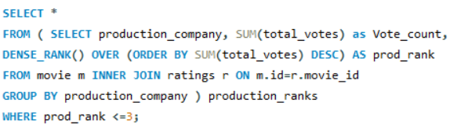
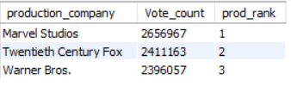
Q3. Which are the top three production houses based on the number of votes received by their movies?

Slide 7
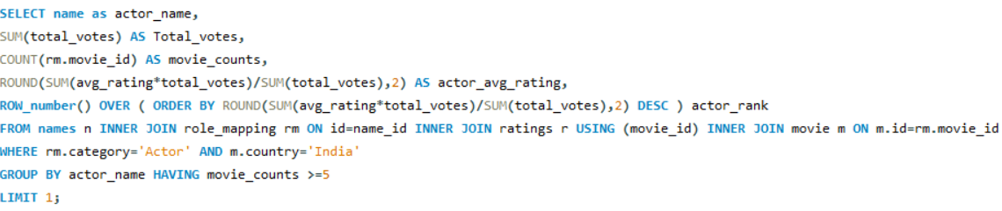
Q4. Rank actors with movies released in India based on their average ratings. Which actor is at the top of the list.

Slide 8
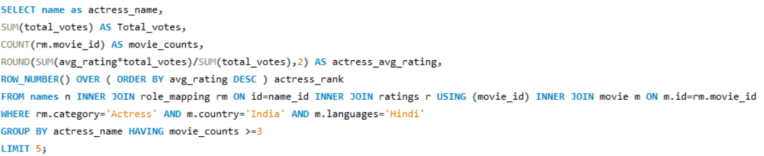
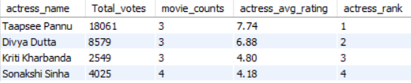
Q5.Find out the top five actresses in Hindi movies released in India based on their average ratings?

Slide 9
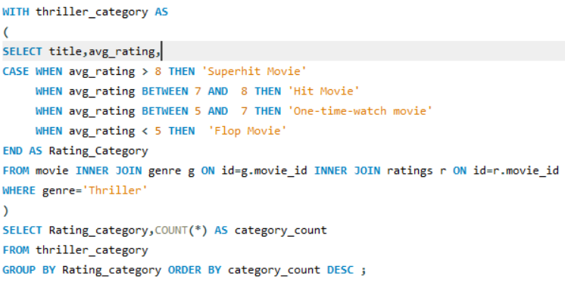
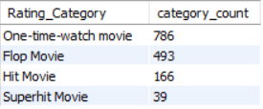
Q6. Select thriller movies as per avg rating and classify them in the following category and summarize it: Rating > 8: Superhit movies
Rating between 7 and 8: Hit movies
Rating between 5 and 7: One-time-watch movies
Rating < 5: Flop movies

Slide 10

SUMMARY
James Mangold is the top director in the top three genres whose movies have an average rating > 8.
Mammootty and Mohanlal are the top two actors whose movies have a median rating >= 8.
Marvel Studios production company rules the movie world with highest votes received .
Top Indian Actor is Vijay Sethupathi with an average rating of 8.4 and Top Inidan Actress is Taapsee Pannu with an average rating of 7.7.
In Thriller genre, we have 39 Superhit, 166 Hit, 493 Flop and 786 One-time-watch movies.

Slide 11
THANK YOU!

